Slide 1


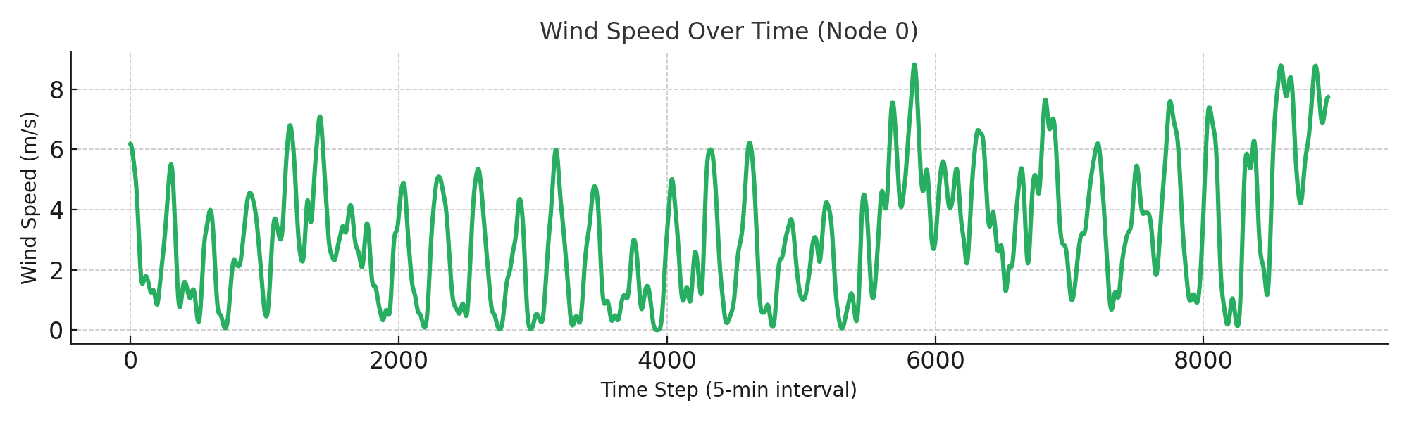
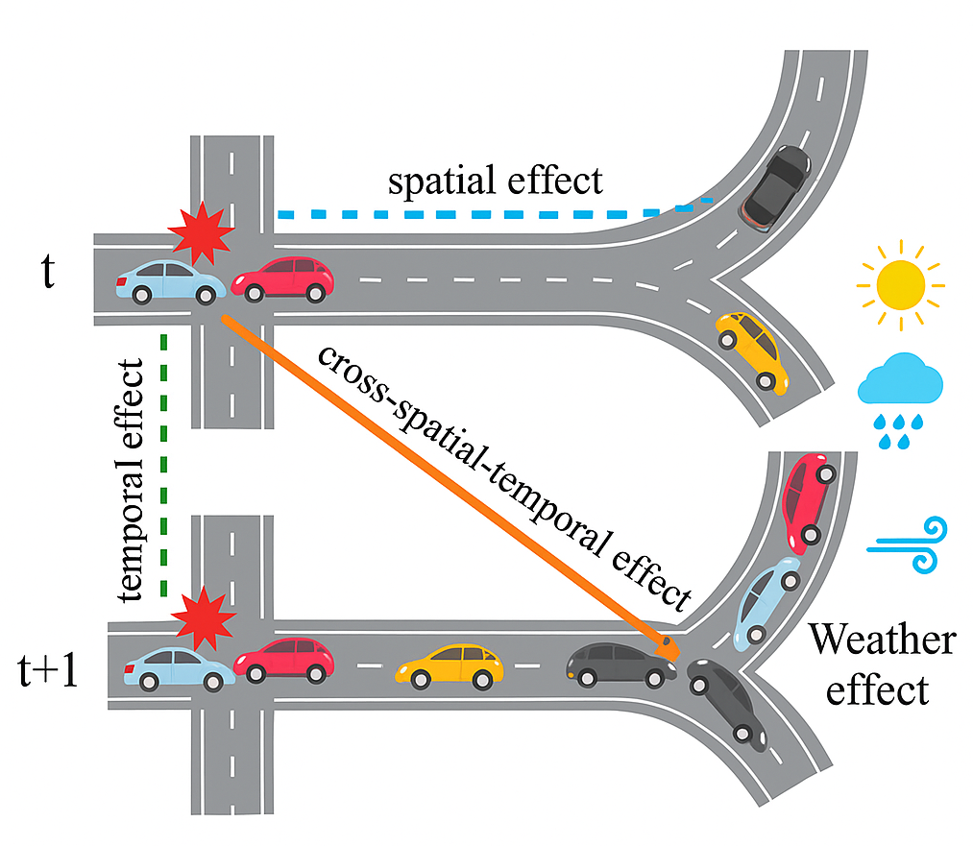
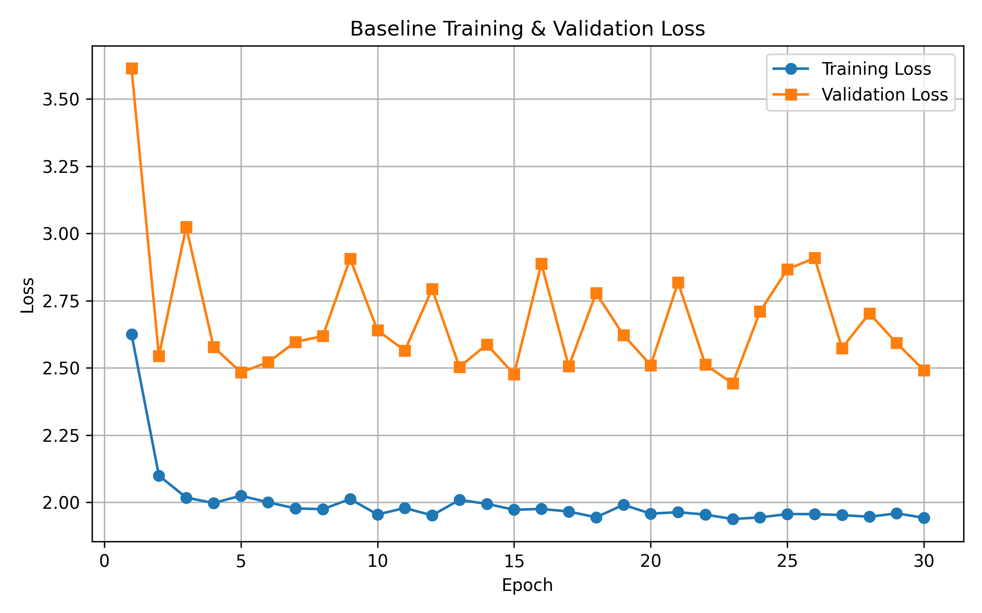
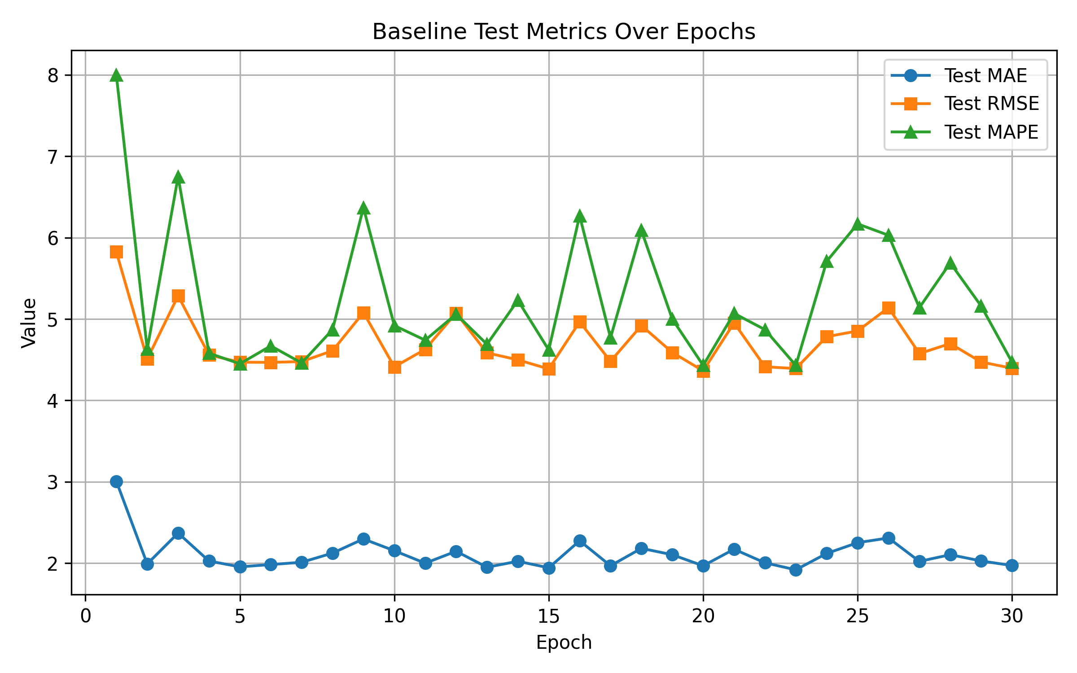
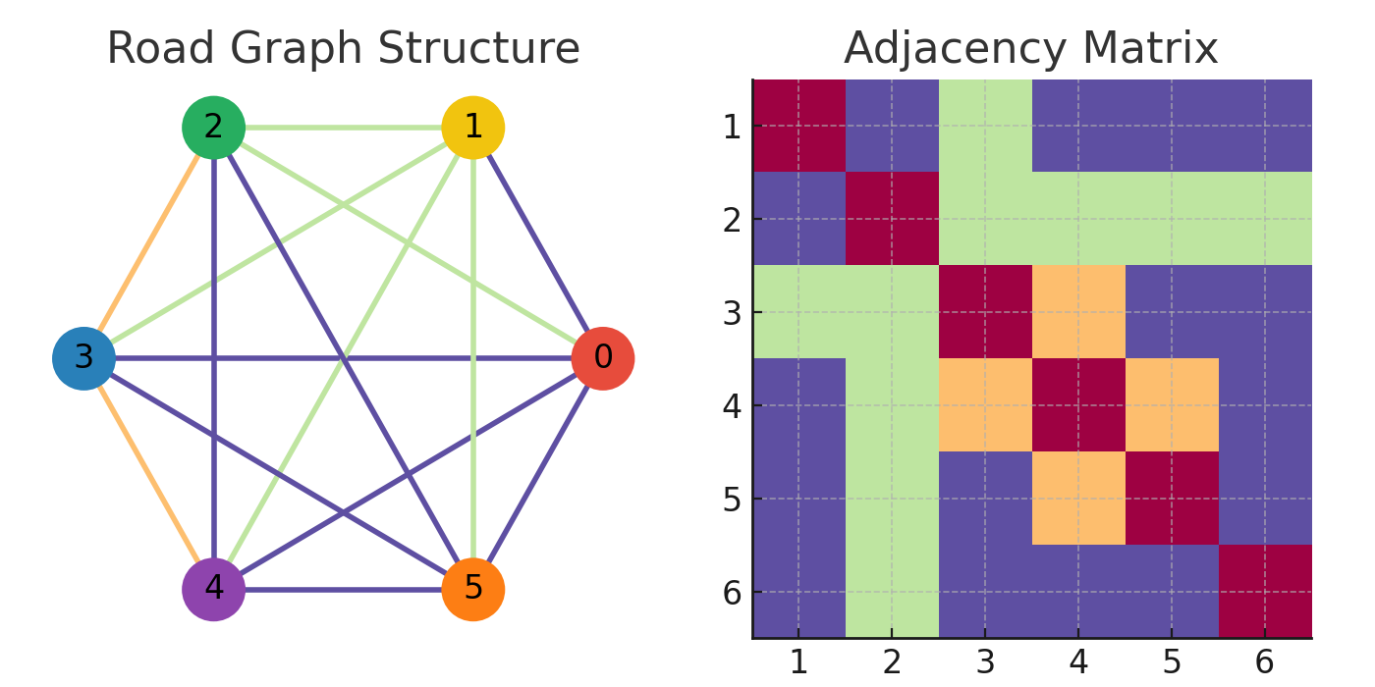
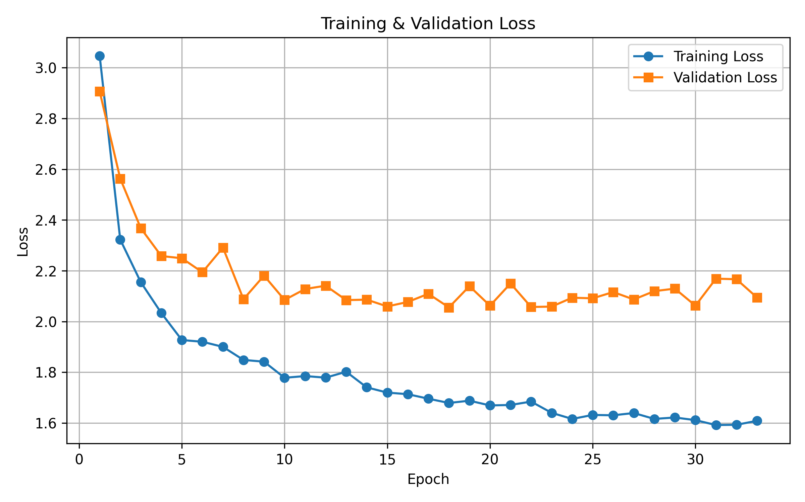
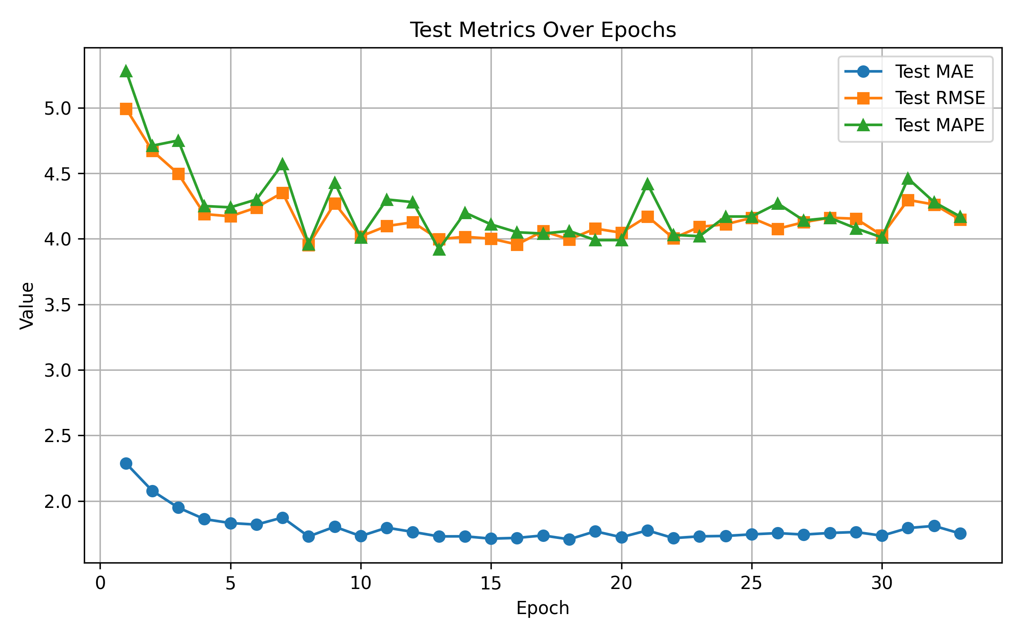
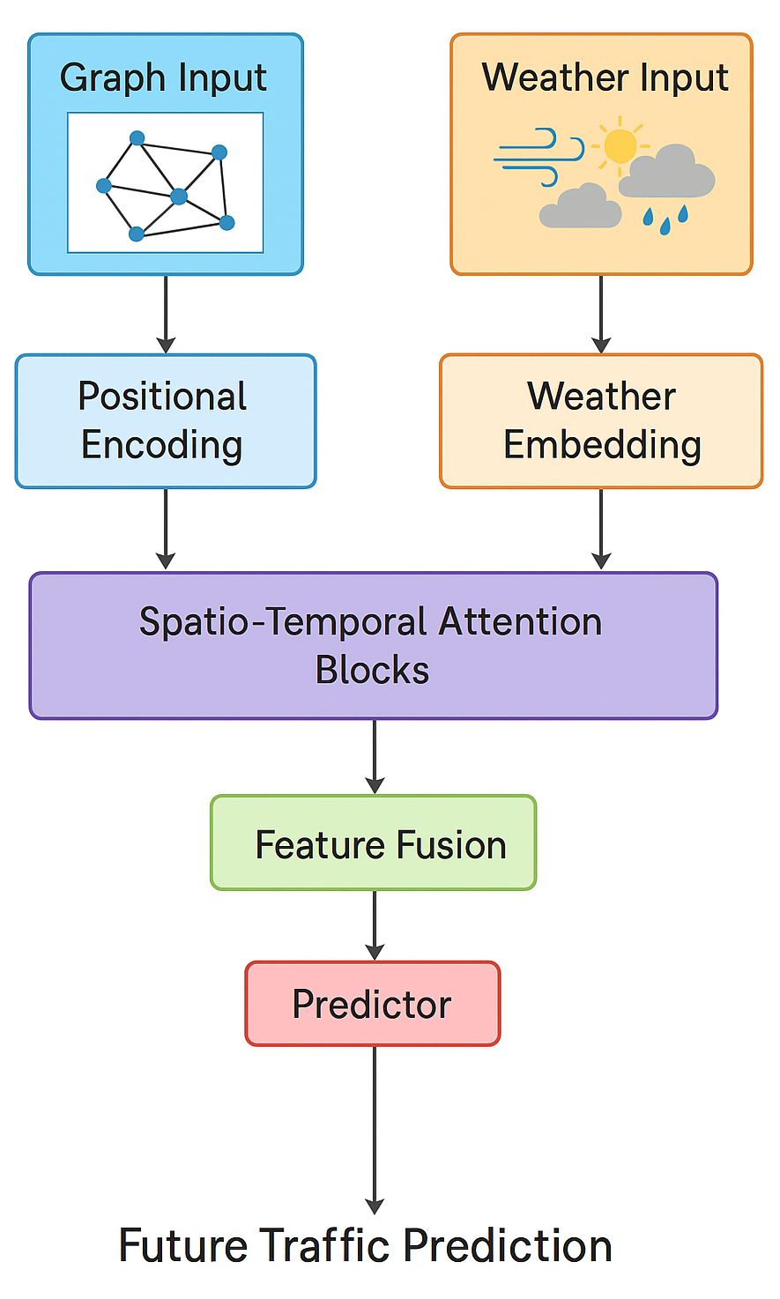
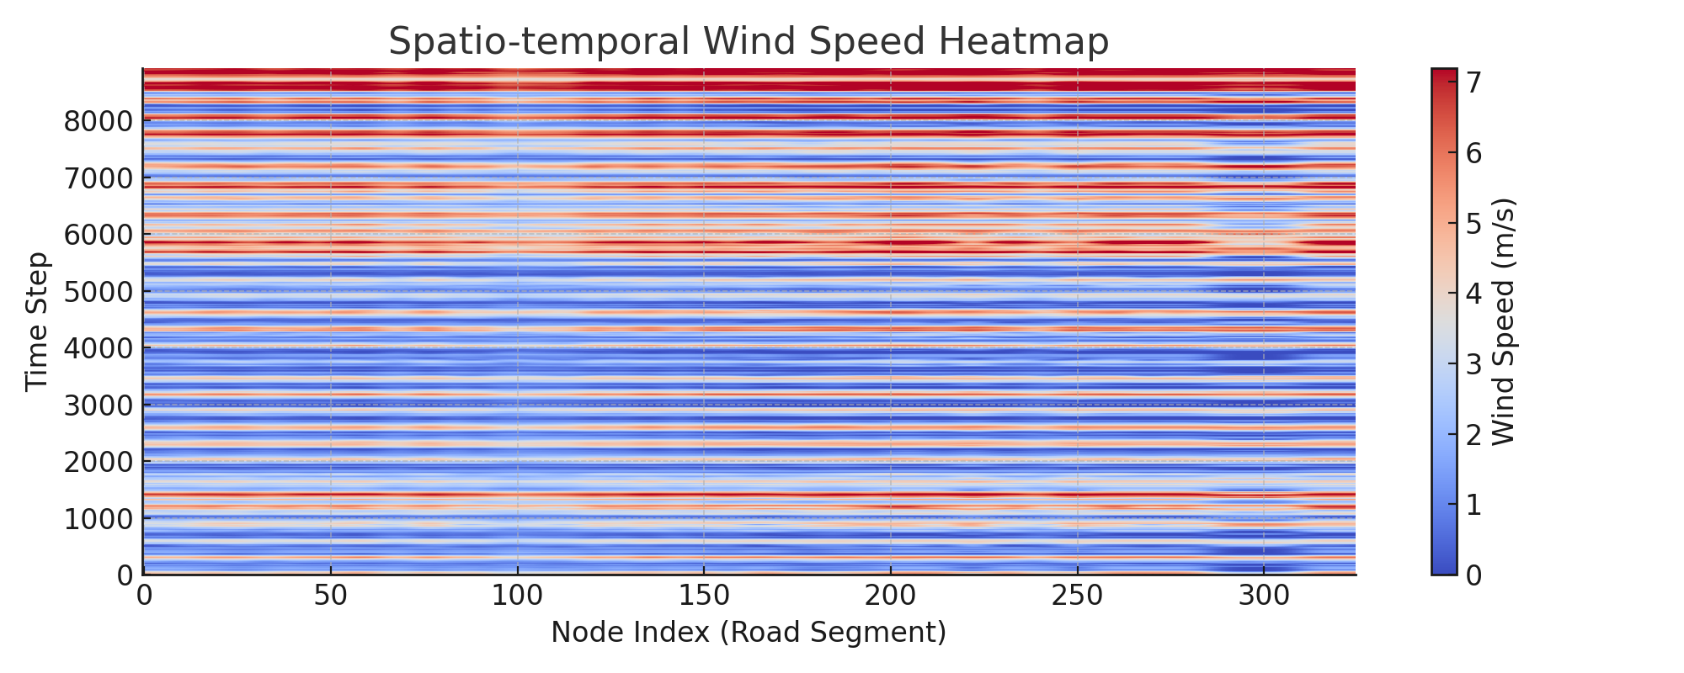
Spatio-Temporal Traffic Flow Forecasting
Integrating Road Graphs and Weather
Changwei Jing, Yanxi Chen, Alan Xu
Department of Electrical and Computer Engineering, University of California - San Diego
Introduction
Dataset
I
I
Short-term traffic flow forecasting is critical for smart city management. While most models only use past traffic data and road networks, they often overlook the effects of weather. In practice, weather conditions like wind or rain can greatly impact traffic and prediction accuracy. This project introduces a deep learning method that combines road graphs, temporal patterns, and weather data. This joint approach leads to more accurate and robust traffic predictions under different weather scenarios.
The dataset combines spatio-temporal traffic data, weather features, and road network topology from 325 road segments.
Graph Structure: The road network is represented as a fixed graph where nodes are road segments and edges encode spatial connectivity.
Traffic Data: Traffic speed is recorded over time for all road segments at regular intervals, forming a spatio-temporal sequence.
Weather Data: Wind speed is collected at each road segment and aligned with traffic time steps for joint modeling.
Figure 6: Wind speed variation at a sample road segment (Node 0) over time
Results
Figure 1: Illustration of spatial, temporal, and weather effects on traffic flow over time
Related Work
Recent works have applied deep learning to spatio-temporal traffic forecasting. DCRNN [1] uses diffusion convolution and recurrent networks to model traffic flow dynamics. ASTGCN [2] leverages attention-based graph convolution to capture spatial and temporal dependencies. Our work builds upon these approaches by integrating adaptive graph structure and external weather factors, inspired by ASTTN [3].
Figure 7: Training & Validation Loss with Test Metrics Over Epochs of Baseline Model
Type B TDA
Figure 3: Example of a road network and its colorful adjacency matrix representing spatial connectivity.
Method
Here we propose a spatio-temporal deep learning framework that integrates road network structure and weather information for traffic flow forecasting.
Spatio-temporal modeling: Traffic sensor data are organized as graph sequences, where nodes represent road segments and edges capture spatial connectivity. To capture both spatial and temporal dependencies, we adopt local multi-head self-attention over the spatio-temporal graph.
Weather integration: Multi-modal weather features are aligned with traffic data and concatenated as additional node inputs, enabling the model to learn the impact of weather on traffic.
Model architecture: The network stacks spatio-temporal attention blocks and feature fusion layers to jointly process traffic and weather data, outputting future traffic predictions for all road segments.
Figure 8: Training & Validation Loss with Test Metrics Over Epochs of Our Model
Conclusions
Compared to the baseline, our model integrating road graphs and weather achieves lower training and validation loss, and consistently improves test performance in terms of MAE, RMSE, and MAPE. These results demonstrate the effectiveness of incorporating weather features for enhancing prediction robustness under real-world traffic conditions.
Figure 4: Data split for training, validation, and test sets across all road segments
References
J. Chen, Y. Wang, Z. Ye, Y. Wang, and Y. Zheng, “Adaptive graph spatial-temporal transformer network for traffic flow forecasting,” ACM CIKM, pp. 4341–4350, 2022.
S. Guo, Y. Lin, N. Feng, C. Song, and H. Wan, “Attention based spatial-temporal graph convolutional networks for traffic flow forecasting,” AAAI Conference on Artificial Intelligence, vol. 33, pp. 922–929, 2019.
Y. Li, R. Yu, C. Shahabi, and Y. Liu, “Diffusion convolutional recurrent neural network: Data-driven traffic forecasting,” International Conference on Learning Representations (ICLR), 2018.
Figure 2: Spatio-temporal model with weather fusion for traffic prediction
Figure 5: Spatio-temporal heatmap of wind speed for all road segments over time

